Slide 1





Orphan Care System
Presented By:
Yuena Su (002198856)
HaoboZhang (001562318)
YongyanDeng (001565258)

Slide 2
CONTENTS
01
BACKGROUND
02
DESIGN
03
OUR MODEL

Slide 3

Background Information
Our Orphan Care Project aims to provide a comprehensive system for children who do not have homes.
Able orphans raised in our system would engage in not only physical exercises, but also education according to their age.
Disable orphans would receive customized rehabilitation exercises in order to improved their living quality.

Slide 4

DESIGN
Abandoned or left-behind children has been a severe problem around the world, especially for the underdeveloped and developing countries. Inevitably, some people working in the orphanage do not have high education level, therefore, the system is designed to be easy to use for everyone without any technical knowledge.
In the end, our project shows the possible fusion of the systematic services and personalized aid in order to make every orphan happy.

Slide 5
Contribution
Yongyan Deng: UI & Component of Fitness Enterprise and Integration of the whole ecosystem.
Haobo Zhang: School & Wholesaler Enterprises in the whole system and give assistance to UI design.
Yuena Su: Orphan enterprise in the whole system, wholesaler test panel, and powerpoint

Slide 6
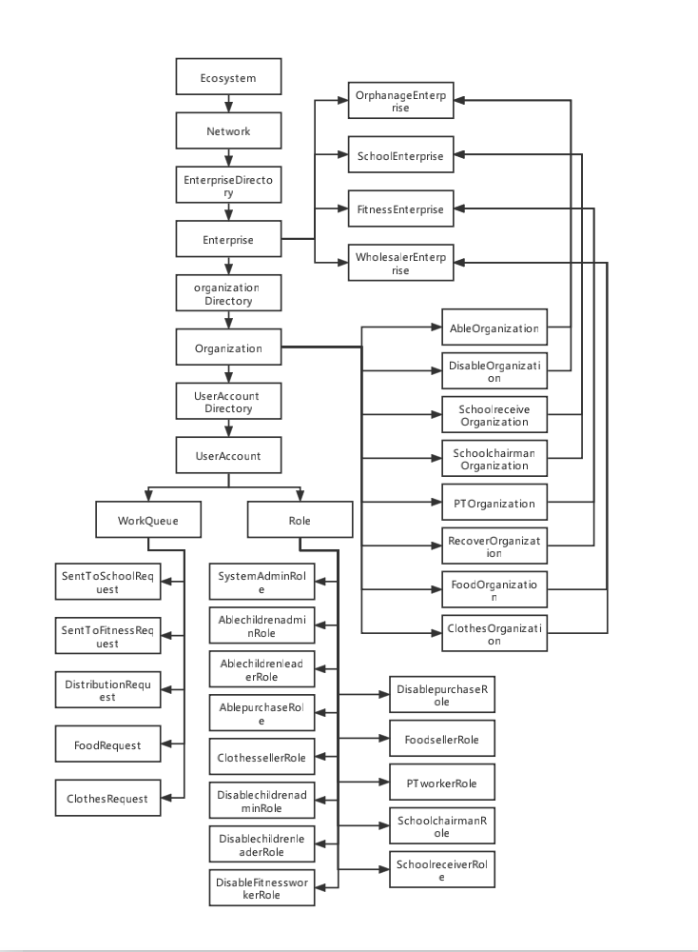
OUR MODEL

